Slide 1
"Pakistan E-Commerce Insights"
"Data-Driven Analysis of Retail Trends (2016-2018)"

Slide 2
Introduction
Overview of the Dataset
The largest publicly available retail e-commerce dataset from Pakistan, featuring over half a million transaction records from March 2016 to August 2018. It includes detailed information on orders, payment methods, and product categories, providing valuable insights into Pakistan's e-commerce market..
Purpose of the Analysis
To uncover trends and patterns in Pakistan's e-commerce sector. The insights aim to help businesses and startups better understand customer behavior and optimize their offerings to tap into the growing market.
Data Collection
Collected as part of a research study, this dataset represents a broad cross-section of the e-commerce industry in Pakistan, covering multiple product categories and payment methods.

Slide 3
Dataset Details
Data Fields
Order ID (order_id): A unique identifier for each transaction.
Category (category): The product category for each order, such as Fashion, Electronics, Mobiles, Appliances, etc.
Payment Method (payment_method): The payment method used for each transaction, including options like Cash on Delivery (COD), Easy-Paisa, Jazz-Cash, and more.
Total Amount (total_amount): The total monetary value of each transaction.
Order Status (order_status): The status of the order, such as Completed, Canceled, Refunded, or Received.
Customer ID (customer_id): A unique identifier for each customer.

Slide 4
Data Cleaning and Preparation
Before analysis, the data was carefully cleaned to ensure accuracy. This included:
Handling missing values by either imputing or removing them where appropriate.
Categorizing data fields to standardize formats, such as ensuring consistent naming for payment methods and product categories.
Aggregating sales and order data by different time periods (e.g., quarterly, yearly) for trend analysis.

Slide 5
Dashboard Overview
Introduction to the Dashboard
The Power BI dashboard provides a comprehensive view of Pakistan's e-commerce market, highlighting key metrics like total sales, orders, and customers. It’s interactive, allowing users to drill down into specific time periods, product categories, and payment methods for deeper insights.

Slide 6
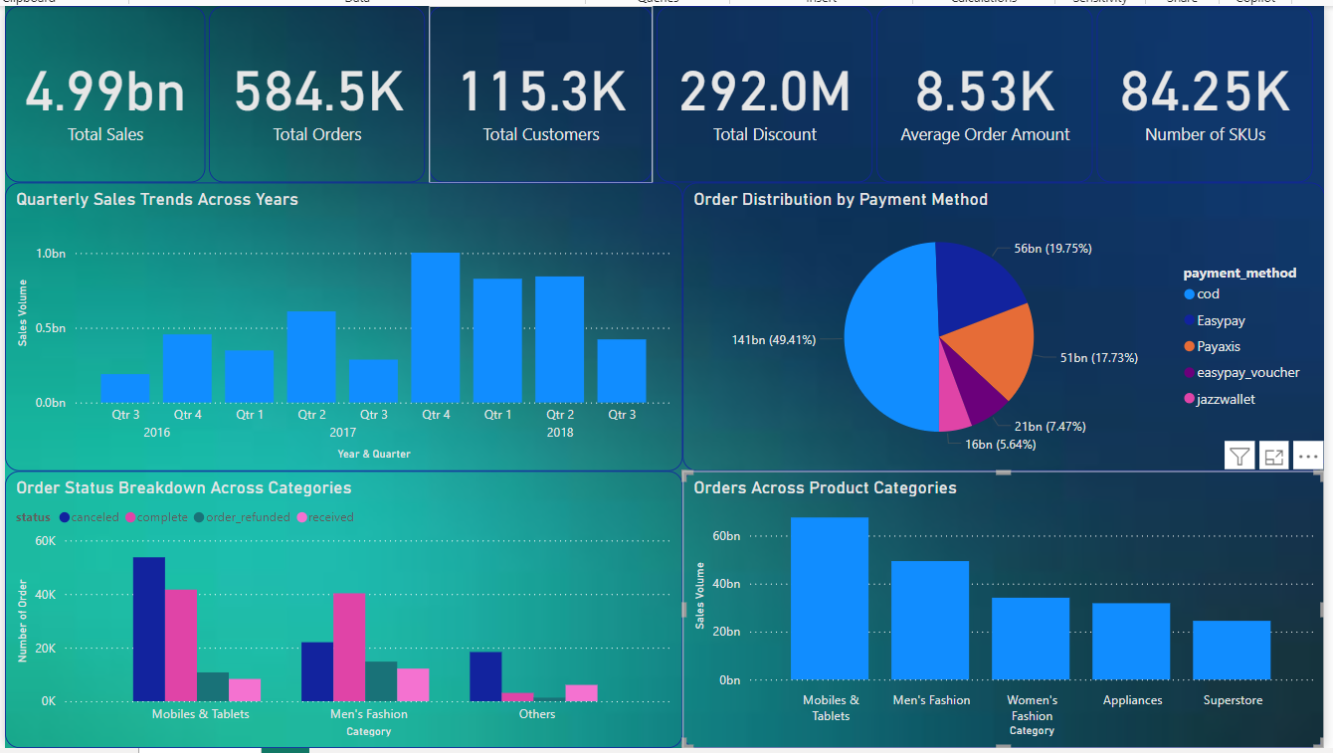

Slide 7
Key Metrics Displayed
Total Sales (4.99bn): The cumulative sales volume over the entire dataset period.
Total Orders (584.5K): The total number of orders placed.
Total Customers (115.3K): The total number of unique customers who placed orders.
Total Discount (292.0M): The total value of discounts provided across all orders.
Average Order Amount (8.53K): The average monetary value per order.
Number of SKUs (84.25K): The total number of unique Stock Keeping Units (SKUs) represented in the dataset.

Slide 8
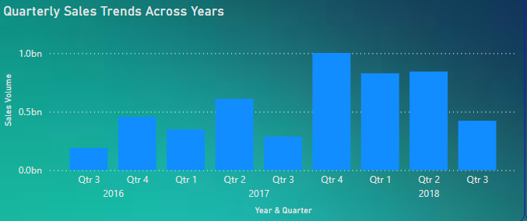
Insights from the Dashboard
What are the Quarterly Sales Trends Across Years?
The "Quarterly Sales Trends Across Years" chart reveals how sales have fluctuated over different quarters from 2016 to 2018. For example, there is a noticeable spike in sales in Q4 of 2017, possibly due to seasonal shopping events like Black Friday. Conversely, Q1 tends to show lower sales, which could be attributed to post-holiday season slowdowns.

Slide 9
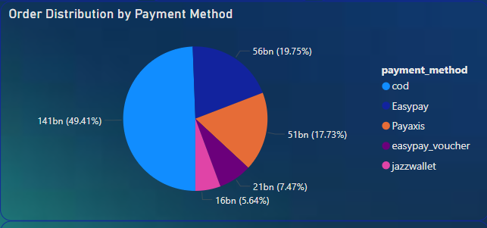
Insights from the Dashboard
Which Payment Method is Most Preferred?
According to the "Order Distribution by Payment Method" pie chart, Cash on Delivery (COD) is the most preferred payment method, accounting for nearly half of all transactions (49.41%). This preference highlights the importance of COD in the Pakistani e-commerce market, likely due to consumer trust and convenience factors

Slide 10
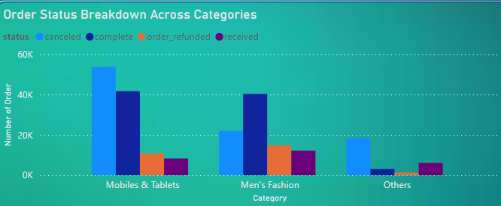
Insights from the Dashboard
Which Product Category has the Highest Order Volume?
The "Orders Across Product Categories" chart shows that "Mobiles & Tablets" is the top-selling category, followed by "Men's Fashion." This indicates a strong consumer demand for electronics and fashion items, reflecting current market trends in Pakistan's e-commerce sector.

Slide 11
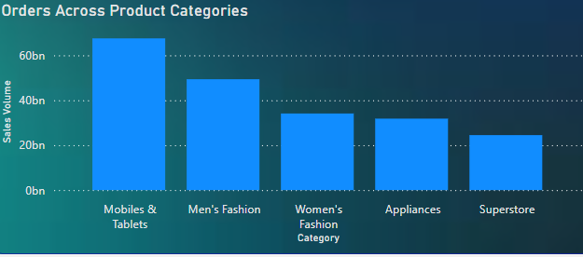
Insights from the Dashboard
What is the Status of Orders Across Different Categories?
The "Order Status Breakdown Across Categories" chart provides insights into the distribution of order statuses across various categories. For instance, the "Mobiles & Tablets" category shows a higher rate of completed orders, while categories like "Others" have a relatively higher proportion of canceled or refunded orders. This could indicate varying levels of customer satisfaction or product issues across different categories.

Slide 12
Conclusion
Summary of Findings
The analysis of this e-commerce dataset provides valuable insights into consumer behavior and market trends in Pakistan. Key findings include the dominance of COD as a payment method, the popularity of electronics and fashion categories, and the seasonal fluctuations in sales. These insights can inform better decision-making for businesses looking to enter or expand within the Pakistani e-commerce market.
Implications for Startups
For startups, understanding these trends is crucial. The preference for COD suggests that offering this payment option could be critical to success. Additionally, focusing on high-demand categories like electronics and fashion, and planning for seasonal sales peaks, could significantly impact business growth and profitability.

Slide 13
Appendix
Calculations and Formulas:
Sales Volume: Summation of total_amount for each time period.
Order Count: Count of unique order_id values.
Average Order Value: total_sales / total_orders.

Slide 14
THANK YOU

